Slide 1


Project Members
Praful Nimje
Saritha Chintapalli
Tushar Khot
Jyoti Borhade
Arun Neerudu
Kuldeep Bagga
Suresh Ganeshan
Project Name
Human Resources
Employee Retention

Slide 2
Project Objective
Objective :- To analyse Employee Retention Rate for different departments, Average Hourly Rate & Average Working Years, Work life Balance across different departments.
1
2
3
Employee Retention
Attrition Rate
Hourly Rate
HR Analytics
Department wise average Attrition Rate
Average Working Hours for Job Role wise
4
5
6
7
Income Stats
Working Years
Work Life Balance
Promotion
Attrition rate vs Monthly Income Stats
Average working Years for each Department
Job Role vs Work Life Balance
Attrition rate vs Year Since Last Promotion

Slide 3

Timeline
Implementation of KPI’s using Tableau - Part I
Understand the Dataset and KPI’s
Implementation of KPI’s using Power BI
10th July’22
24th July’22
7th Aug’22
21st Aug’22
Project Kick-off Meeting
Implementation of KPI’s using Excel & MySQL
Implementation of KPI’s using Tableau – Part II
Final Presentation of the Project
17th July’22
31st July’22
14th Aug’22

Slide 4
Data Set Details
Dataset Name :- HR_1 & HR_2
Dataset Type :- Excel Data
Dataset Size :- 50k Records Each

Slide 5
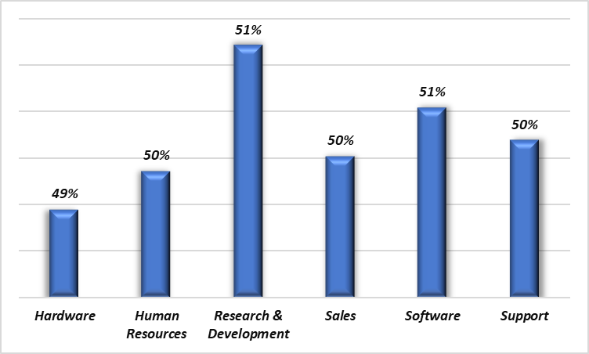
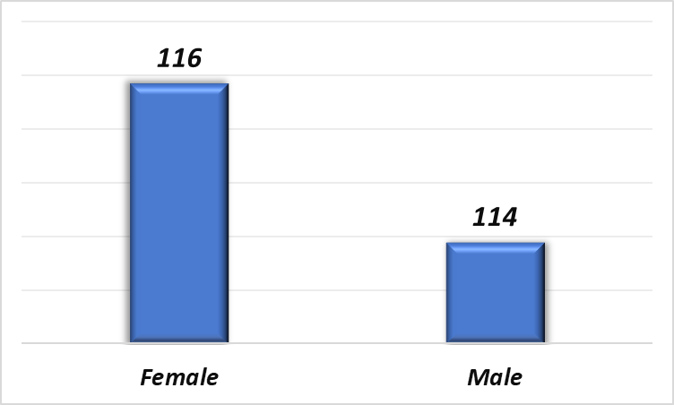
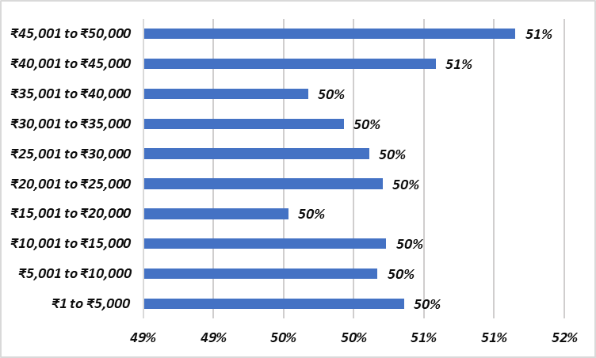
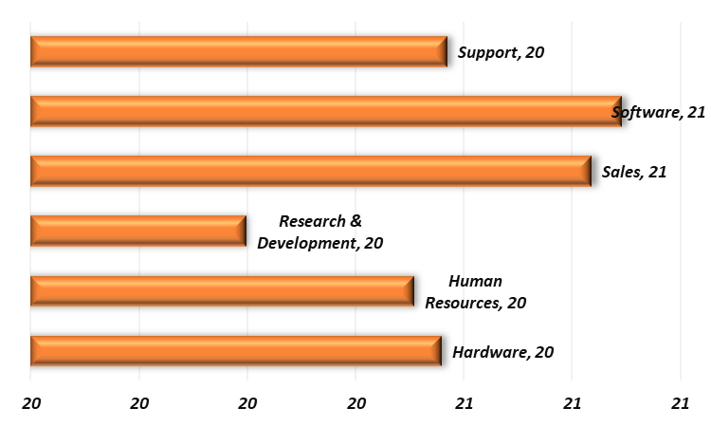
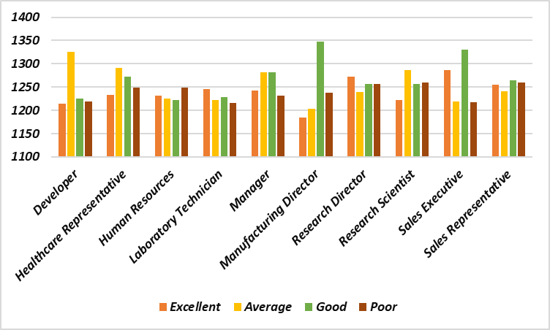
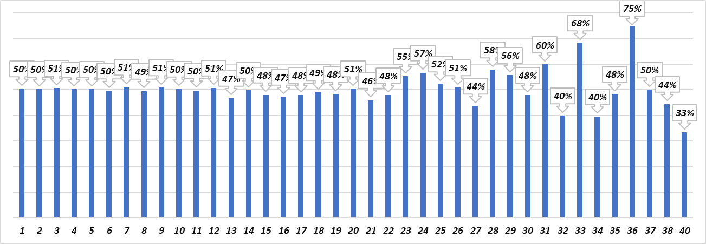
KPI DASHBOARD
Total No of Employees
Gender Wise No of Empl
Average Salary
Average Working Years
Over-All-Attrition
50,000
24,941
25,059
26,016
20.50
50.21%
Average Attrition rate for all Departments
Average Hourly rate of Male Research Scientist
Attrition rate Vs Monthly income stats
Average working years for each Department
Job Role Vs Work life balance
Attrition rate Vs Year since last promotion relation

Slide 6

Average Attrition Rate for All Departments
Over-All Attrition Rate
50%
Average Attrition rate for all Departments
This KPI show Average Attrition Rate for each Department
Average Attrition Rate = ( Attrition Rate / Total Number of Employees ) * 100
From this Column Chart , We can conclude that Research & Development Department have higher Attrition rate - 51.21 % & Hardware Department have lowest Attrition Rate - 49.44%

Slide 7
Average Hourly rate of Male Research Scientist
Average Hourly Rate
115
116
114
Gender | Average Hourly Rate
Female | 116
Male | 114
Average Hourly rate of Male Research Scientist
This Column Chart shows Average Hourly Rate for Male Research Scientist
Average Hourly Rate of Female is higher than Male Research Scientist.
Average Hourly Rate for Female Research Scientist is 116 hours & Average Hourly Rate for Male Research Scientist is 114 hours

Slide 8
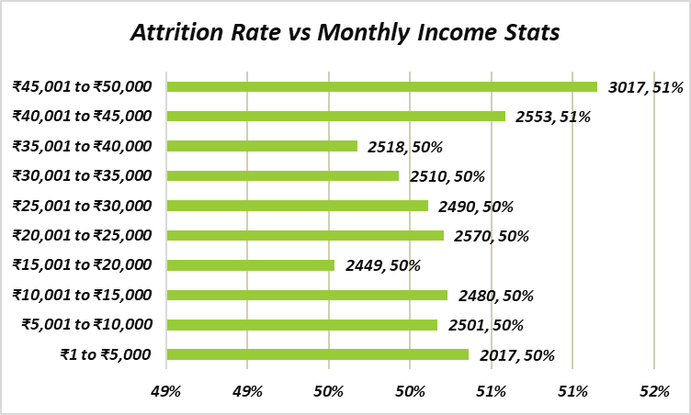
Attrition rate Vs Monthly income stats
Attrition rate Vs Monthly income stats
This KPI shows Attrition Rate vs Monthly Income Stats for different monthly income
Only 2% Employees are earning more than 45,000
Attrition Rate is higher at higher Monthly Income range 40,000 to 45,000 & 45,000 to 50,000 INR which is 51%

Slide 9
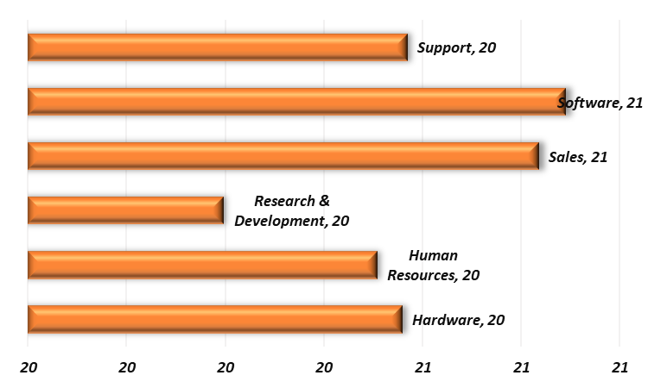
Department Wise Average Working Years
Average Working Hours
20
Average working years for each Department
This KPI shows Average Working Years for each Department
From the above Bar Chart we can conclude that Software & Sales Department have Higher Avg. Working Years compared to other departments like Support , Hardware, Human Resources , Research & Development.

Slide 10
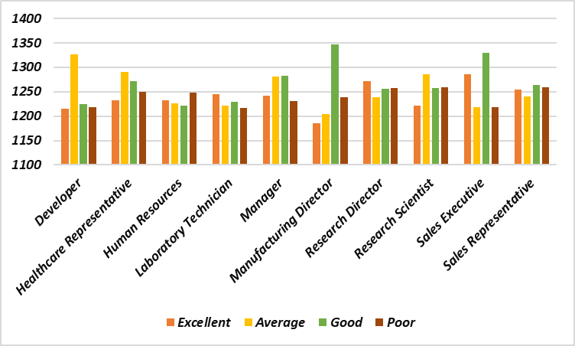
Job Role vs Work Life Balance
Job Role Vs Work life balance
This Column chart shows the Work life Balance factor by Each Job Role
Work life Balance is distinguished between 4 categories – Excellent, Good, Average & Poor in each Job Role
This Column Chart showing Excellent Work life Balance by Job Role in which Sales Executive have Excellent Work life Balance

Slide 11
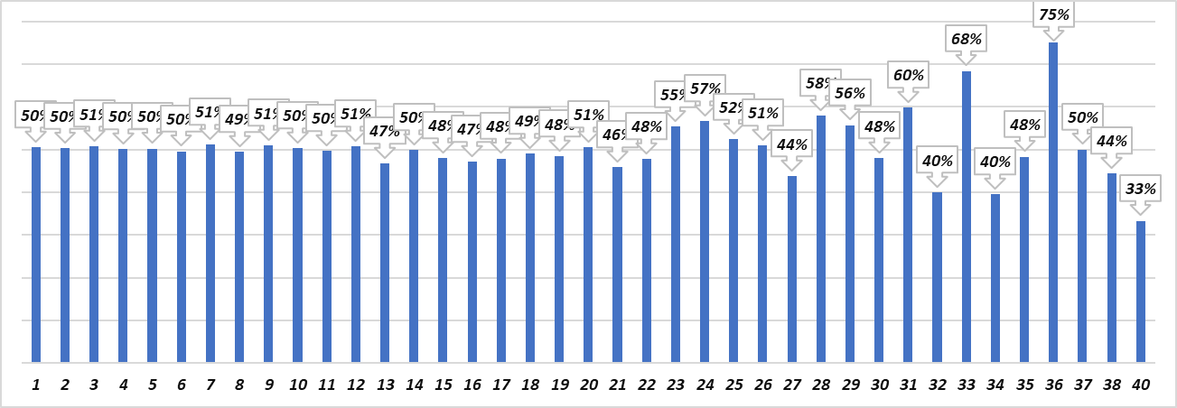
KPI Diagram of Year Since Last Promotion Relation vs Attrition Rate
Attrition rate Vs Year since last promotion relation
This Column Chart shows Attrition Rate vs Year since last promotion relation
Attrition Rate is higher in Since 37 years last promotion which is at 78% and Attrition rate is lowest at 34 years since last promotion which is at 32%

Slide 12
Challenge’s & Overcome
Challenge’s
Overcome
Choosing the best Chart for KPI
Choosing the best KPI Formats to represent our Analysis
Provide Suggestions & Opinion
Help from Mentor
Search on Internet
Team Suggestion

Slide 13
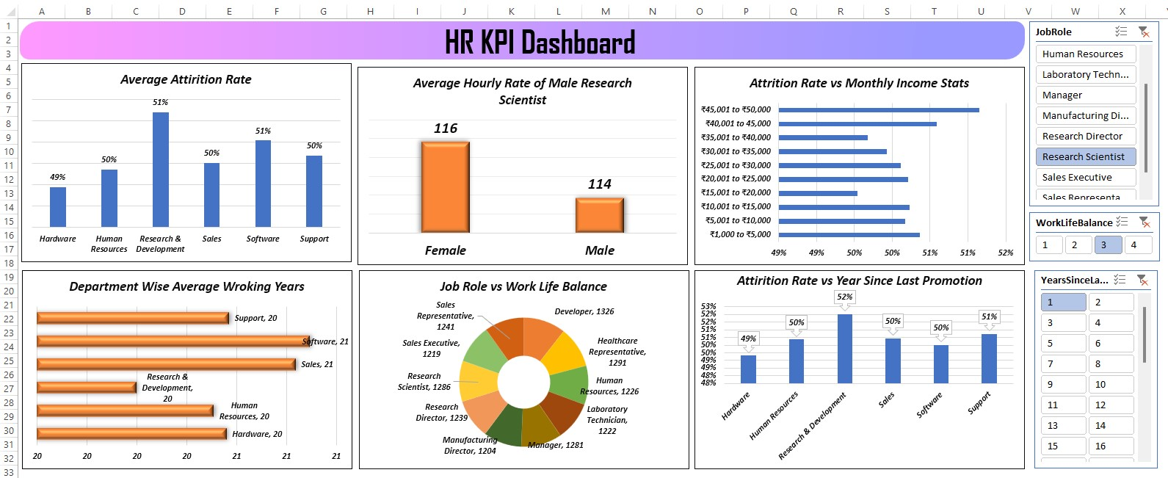
Excel Dashboard

Slide 14
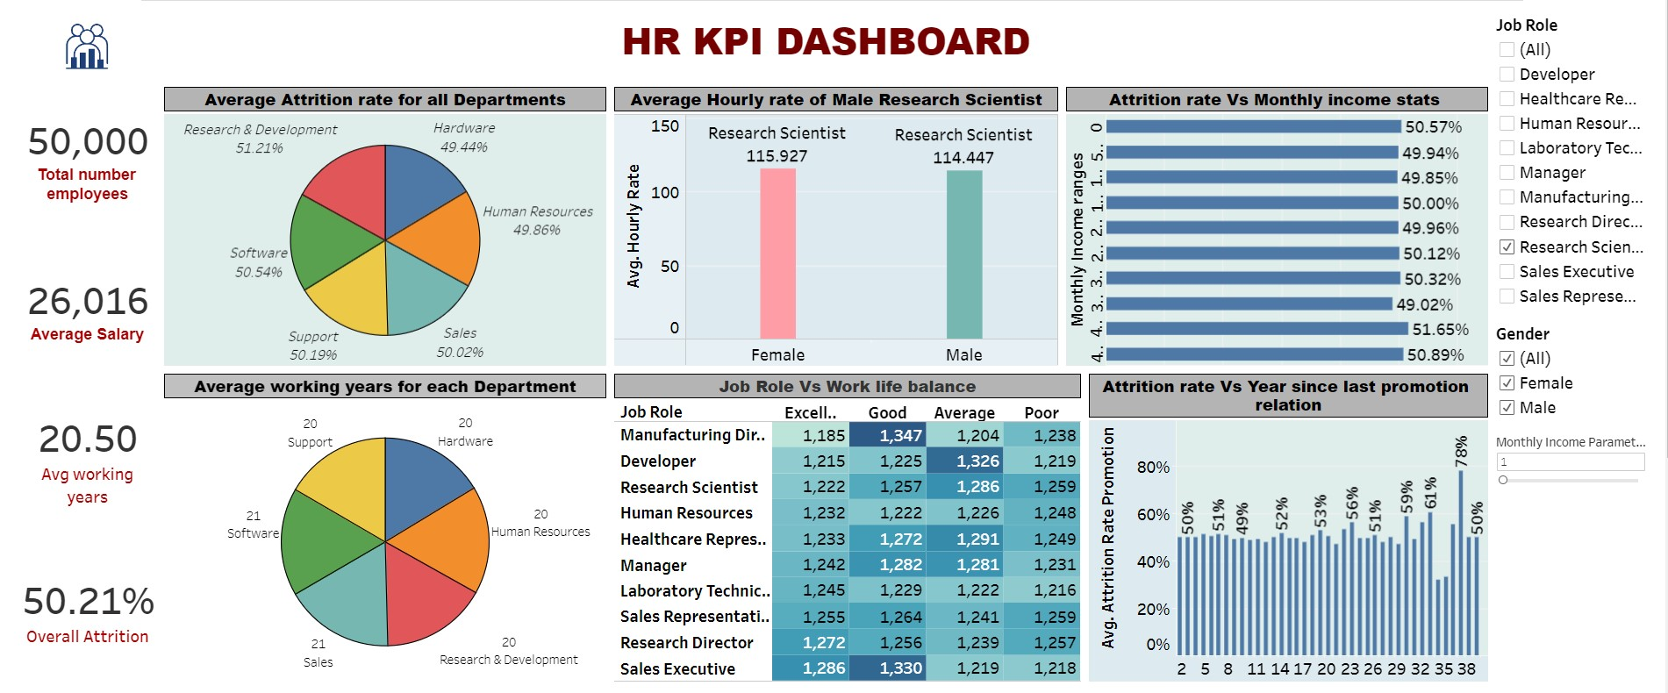
Tableau Dashboard

Slide 15
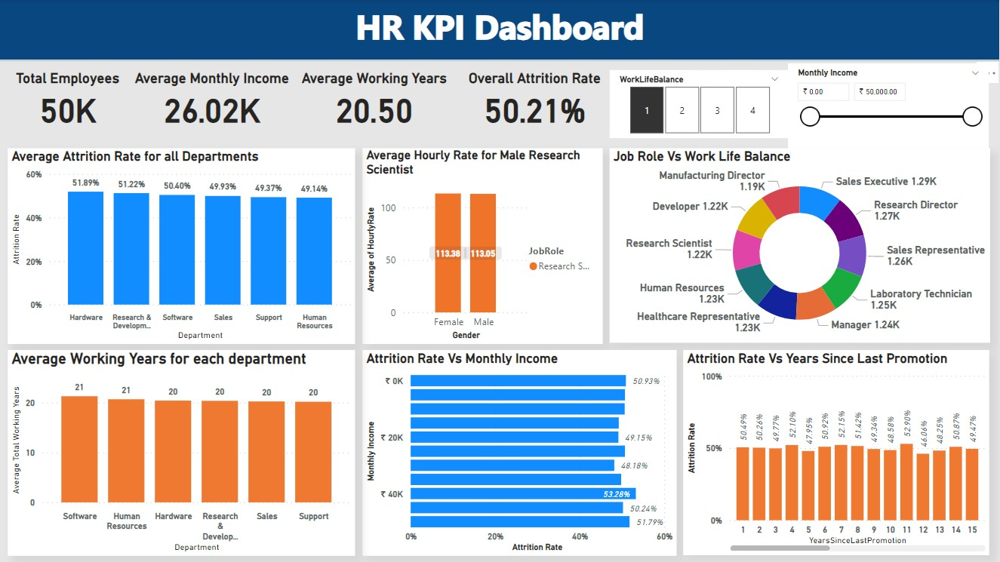
Power BI Dashboard

Slide 16
Thank You

